Slide 1
ECO_AGENT (Eco Lifestyle Agent)
IBM HACKATHON PROJECT
Presented By:
Student name :Shreya Yadav
College Name & Department :Shri Ramswaroop Memorial University
& Bachelor of Technology in Computer Science

Slide 2
OUTLINE
Problem Statement
Technology used
Wow factor
End users
Result
Conclusion
Git-hub Link
Future scope
IBM Certifications

Slide 3
Problem Statement
Many people want to live sustainably but are overwhelmed by too much or conflicting information online.
There is often no clear starting point for adopting eco-friendly habits in daily life.
Lack of personalized guidance makes it difficult to choose the right eco-friendly products or actions.
Sustainable options are often perceived as costly, complex, or inconvenient.
Local recycling rules, green product availability, and government schemes vary by region and are not easily accessible.
Important government and NGO initiatives are underutilized due to poor digital outreach.
Users lack a tool that provides real-time, location-based, and verified environmental information.
People need small, actionable suggestions that are easy to understand and implement in everyday routines.
Current solutions do not offer a user-friendly, conversational interface that adapts to the user's context.
There is a gap in tools that combine AI intelligence with environmental action for everyday decision-making.

Slide 4
Technology used
AI Platform: Agent built using IBM watsonx.ai Agent Lab
Framework & Architecture: LangGraph framework, ReAct architecture
Foundation Model: ibm/granite-3-3-8b-instruct
RAG Retrieval Pipeline for real-time trusted content from environmental and government sources

Slide 5
IBM cloud services used
IBM Cloud Watsonx AI Studio
IBM Cloud Watsonx AI runtime
IBM Cloud Agent Lab
IBM Granite foundation model

Slide 6
Wow factors
Uses Retrieval-Augmented Generation (RAG) to pull live, trustworthy data from government portals, eco-blogs, and NGO databases.
Offers personalized suggestions based on user lifestyle, preferences, and local resources.
Can adapt to urban and rural settings, making sustainability accessible for everyone.
Delivers daily eco-tips and reminders to build long-term habits effortlessly.
Maintains a non-judgmental, empathetic tone, encouraging users rather than criticizing them.
Helps users make eco-conscious shopping decisions by comparing green alternatives.
Enables goal tracking for users to measure their sustainability progress (e.g., plastic saved, energy reduced).
Capable of multilingual interaction to support inclusivity and wider adoption across diverse regions.
Easily scalable to integrate into school systems, smart cities, or community programs.
Provides offline support for storing basic local eco-guides and tips in areas with low connectivity.

Slide 7
End users
Eco-conscious individuals
Urban and rural households seeking sustainable practices
Students and environmental clubs
NGOs and green businesses
Local governments promoting recycling or energy conservation

Slide 8
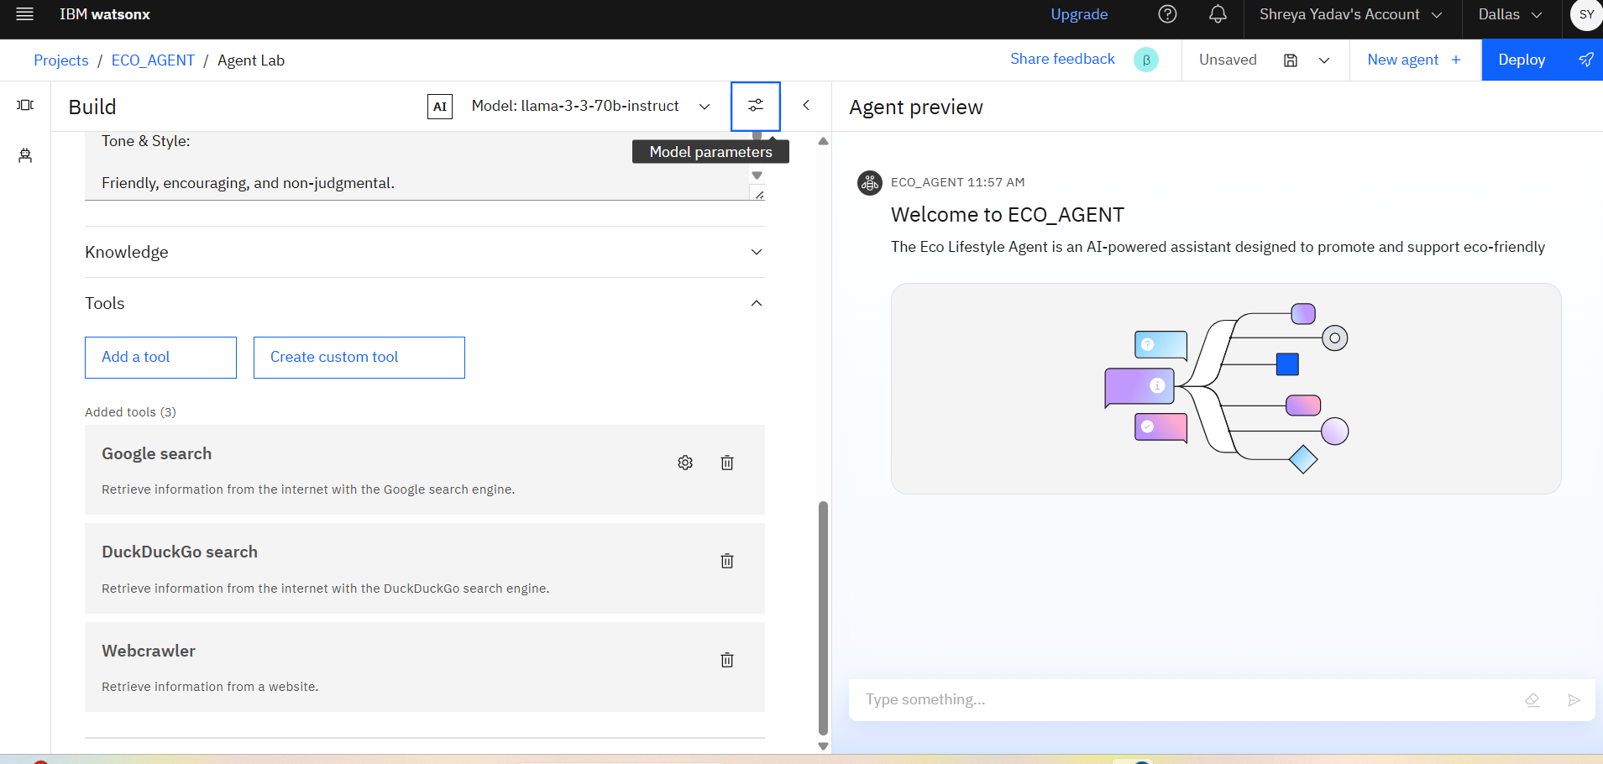
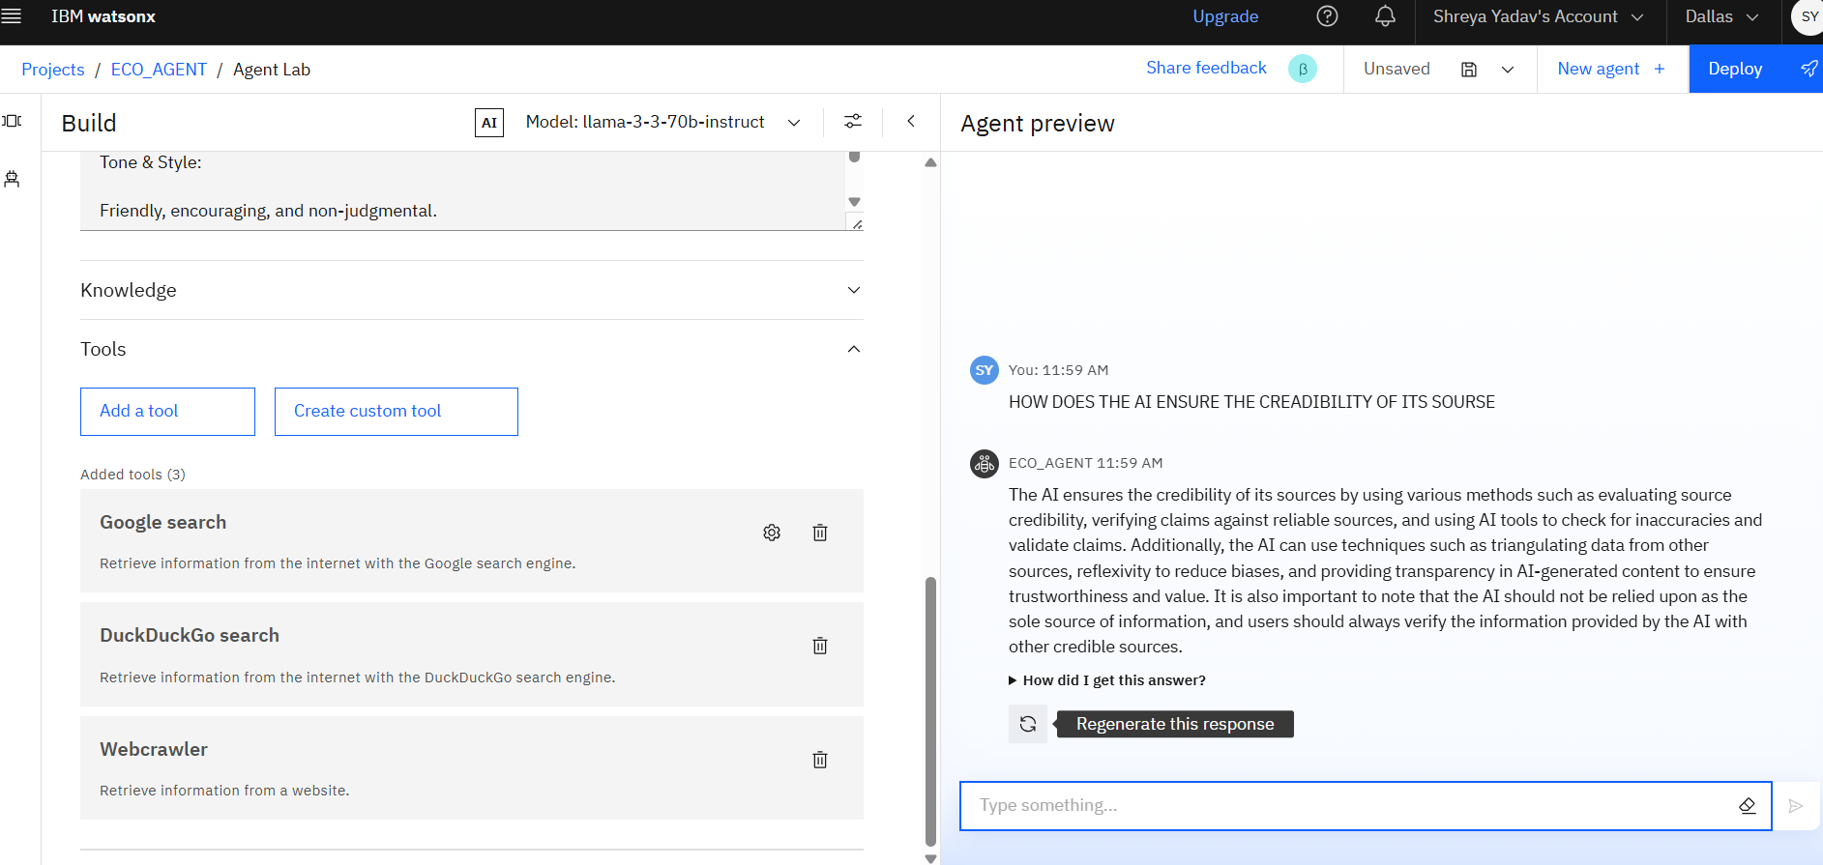
Results
Interface of
ECO_AGENT

Slide 9
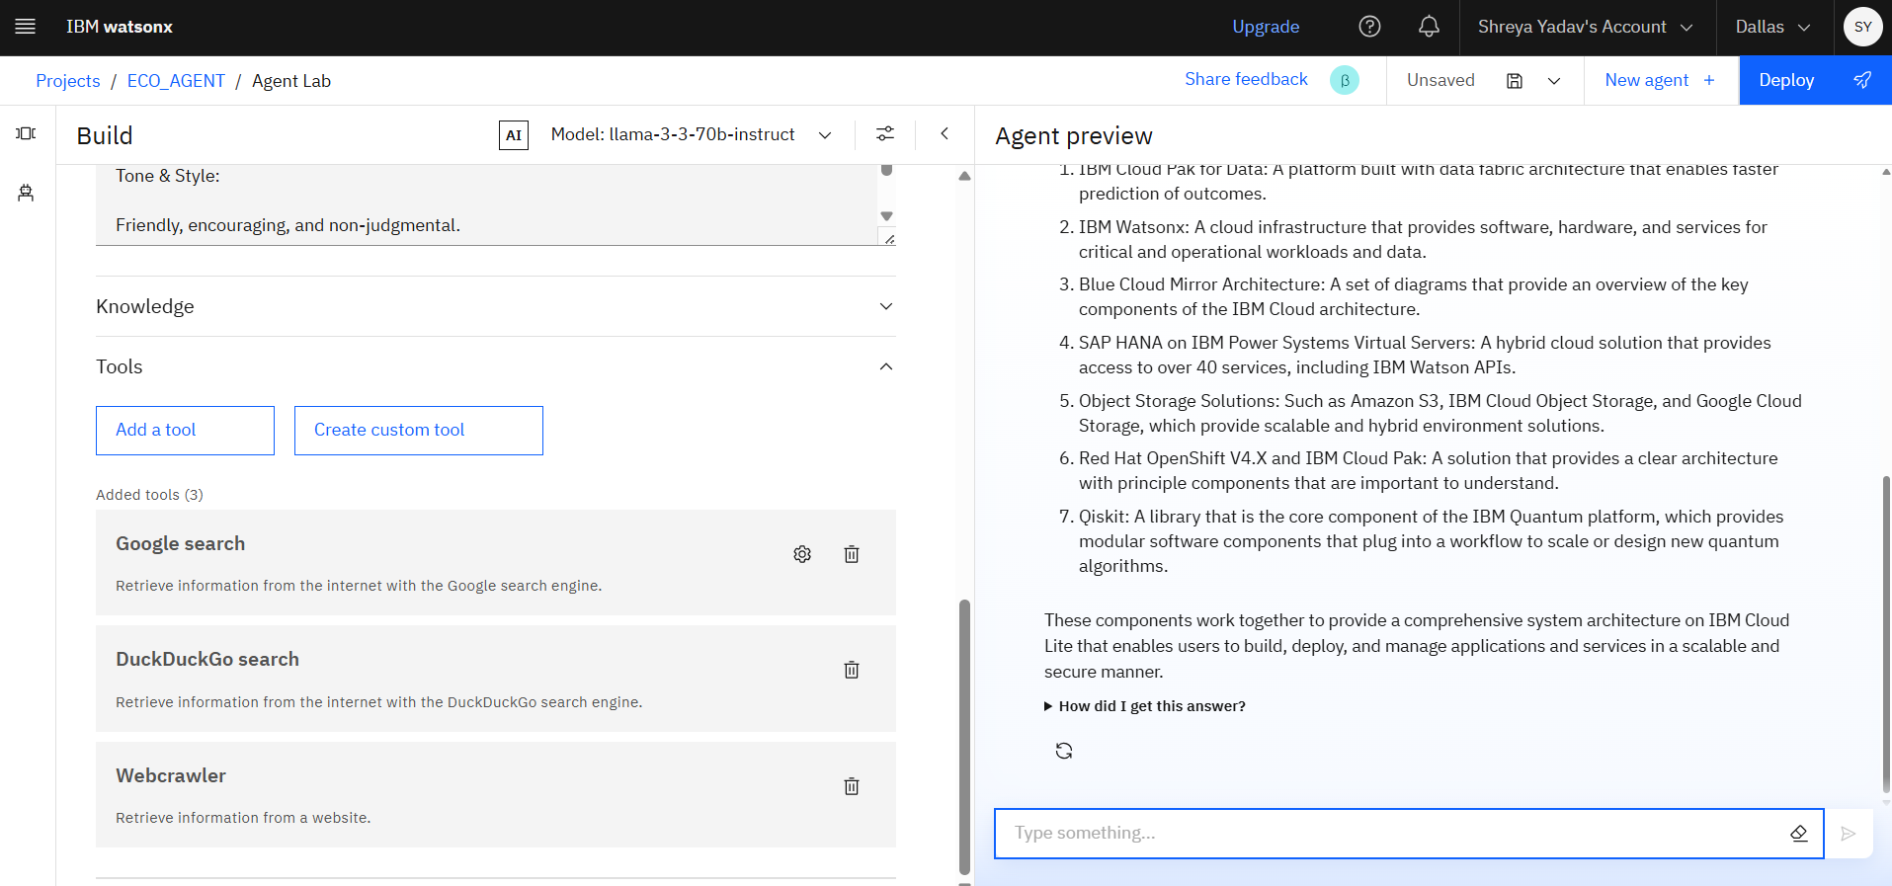
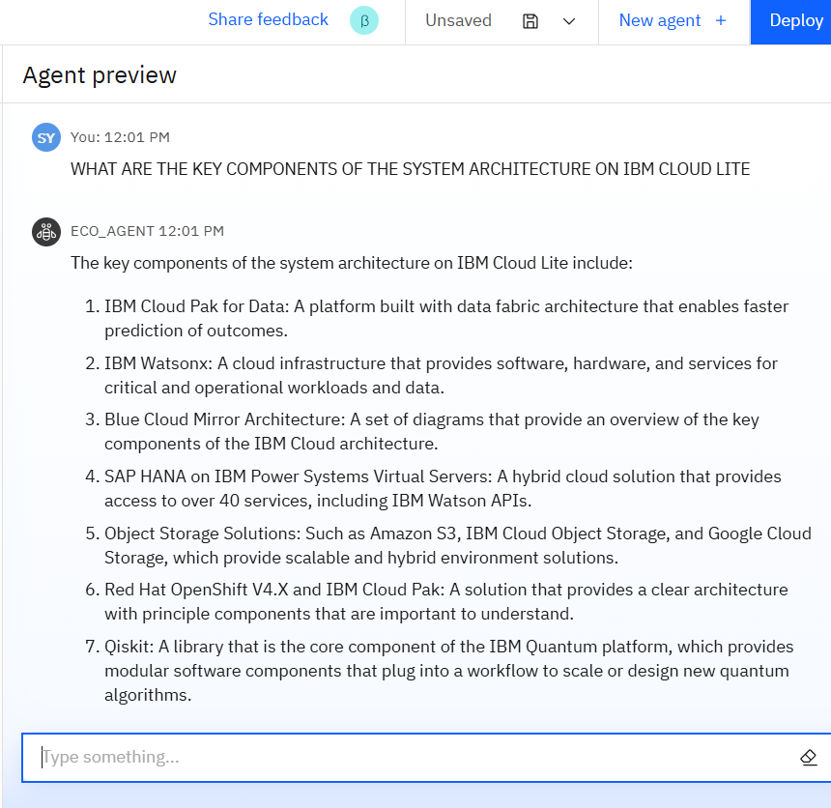
Results
Query about components of
The system architecture on
IBM cloud life

Slide 10
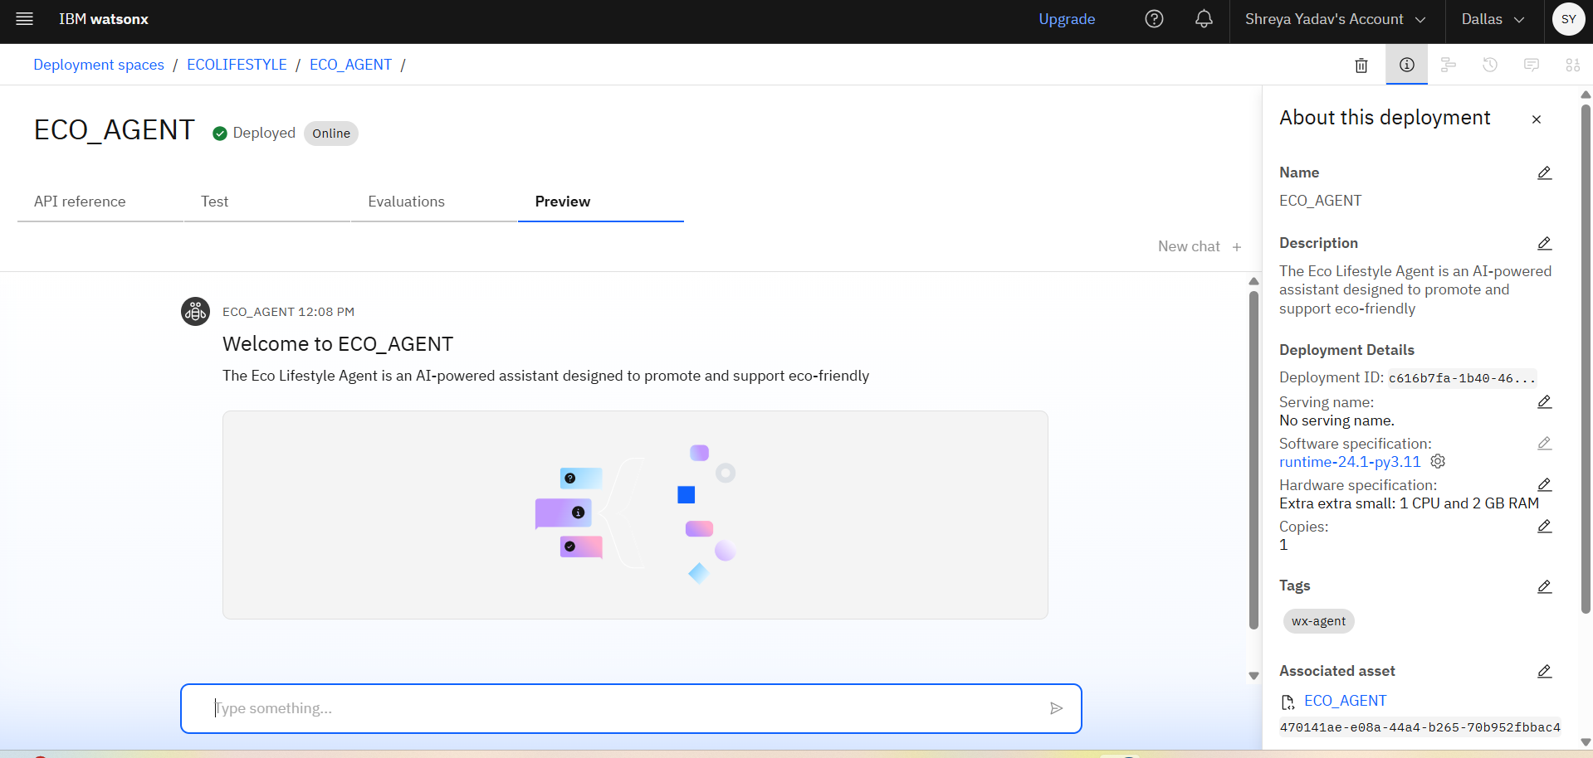
Results
The user input interface

Slide 11
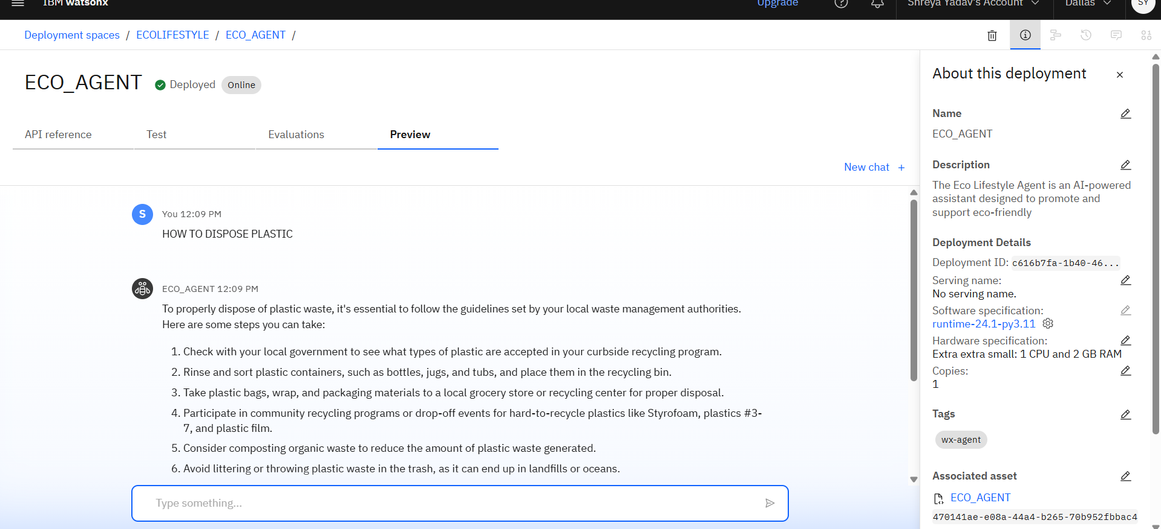
Results
Interface asking
“How can I reduce plastic at home?”

Slide 12
Conclusion
The Eco Lifestyle Agent is a powerful step toward making sustainability practical, personal, and accessible for everyone.
By leveraging IBM Granite and RAG on IBM Cloud Lite, it transforms complex environmental data into simple, actionable guidance.
its friendly tone, real-time information, and personalized support, the agent empowers users to make small choices that lead to big environmental impact—paving the way for a smarter, greener, and more responsible future.

Slide 13
GitHub Link
https://github.com/Shreyayadav111/ECO_AGENT.git

Slide 14
Future scope
Voice-based assistant for low-literacy or elderly users
Smart home & wearable integration
Carbon footprint tracker
Eco-point gamification and rewards system
Partnership with local NGOs and recycling units
Expansion to multilingual and rural-friendly versions

Slide 15
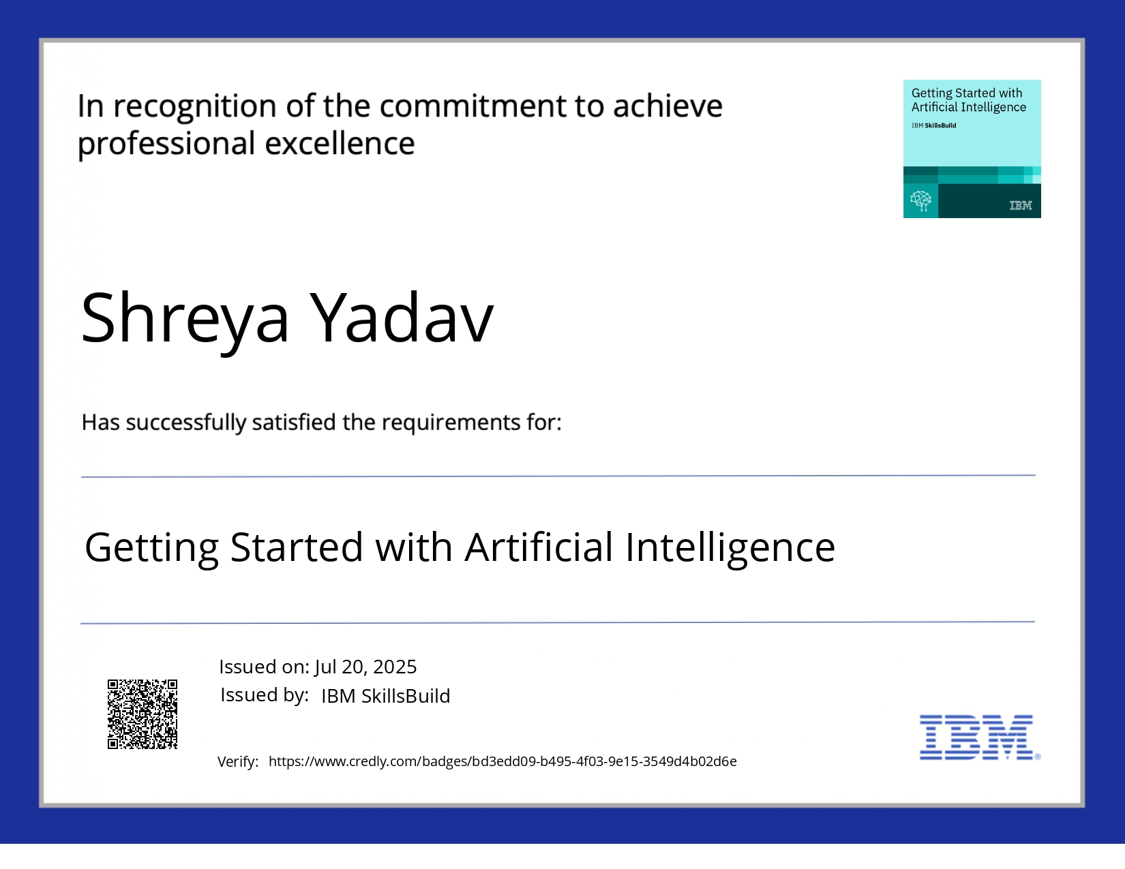
IBM Certifications

Slide 16
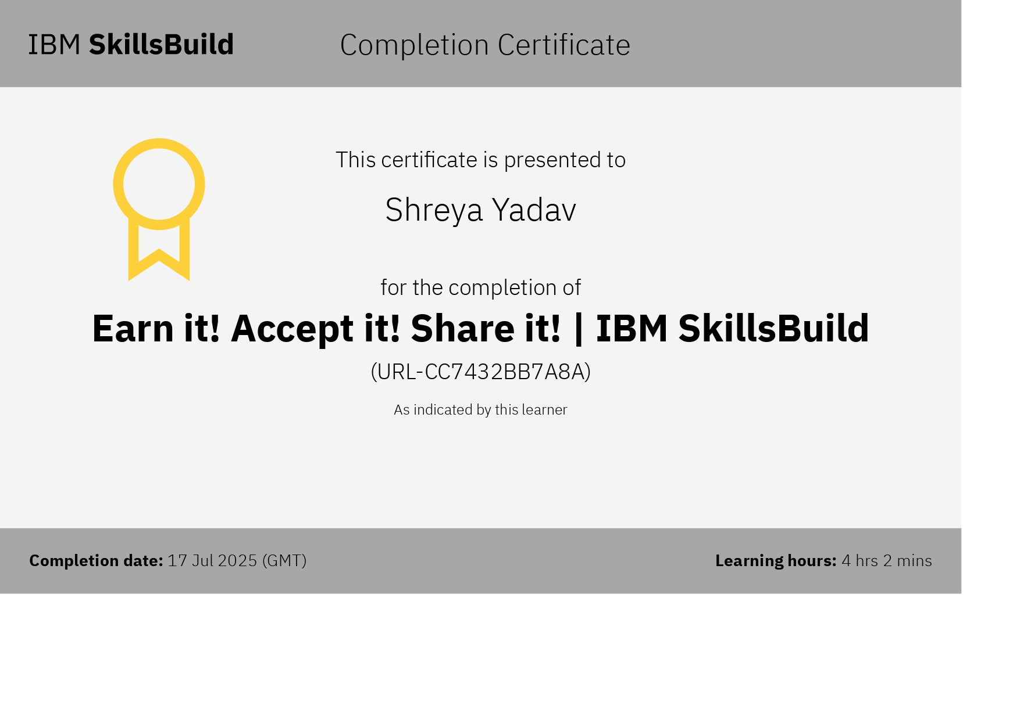

Slide 17
THANK YOU

